Slide 1
Medicaid Access & Coverage in 2019
Graphics Featuring Results from the Institute for Medicaid Innovation’s
2020 Annual Medicaid Managed Care Survey

Slide 4
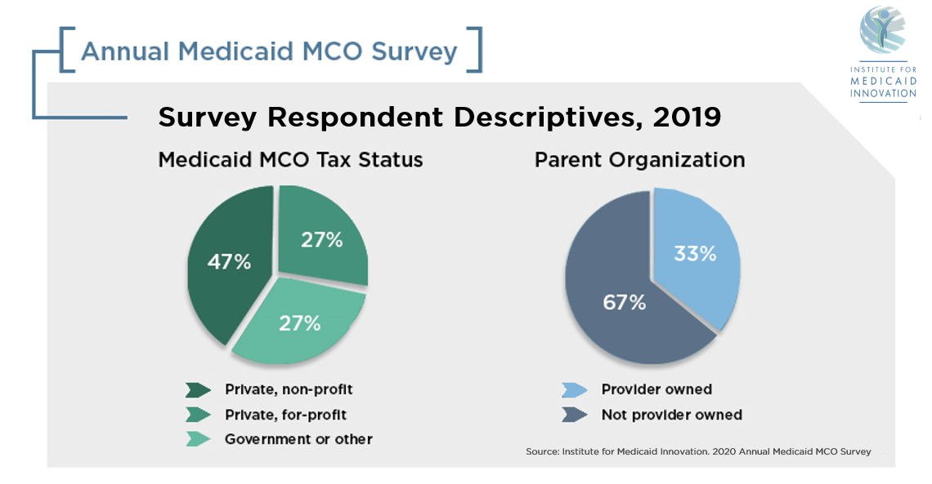

Slide 6
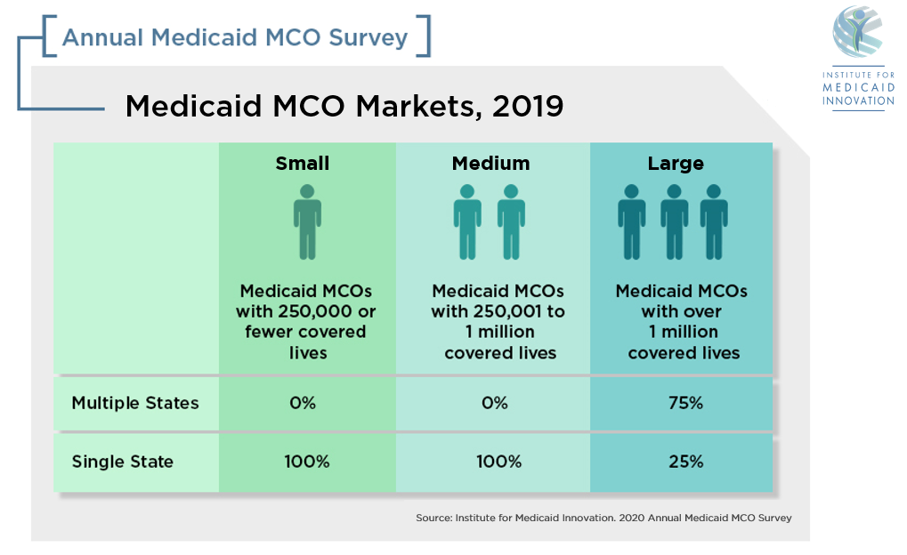
Notes:
Whenever possible, we stratified the findings into three groups, small, medium, and large health plans based on the number of lives covered lives. In 2019, 100 percent of small and medium sized respondents operated in a single state while 75 percent of large health plans had multiple markets.

Slide 7
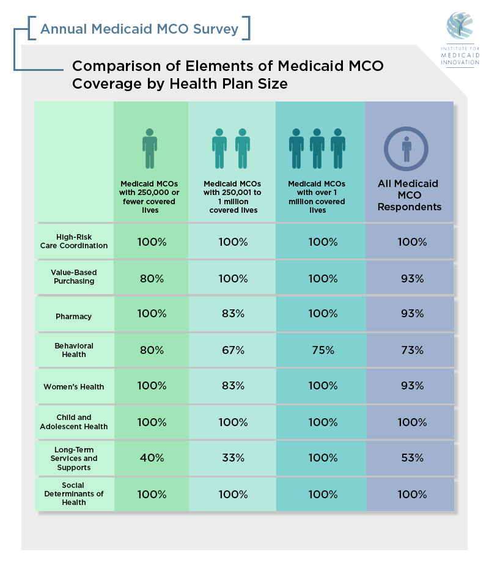
Comparison of Elements of Medicaid MCO
Coverage by Health Plan Size, 2019
Source: Institute for Medicaid Innovation. 2020 Annual Medicaid MCO Survey

Slide 8
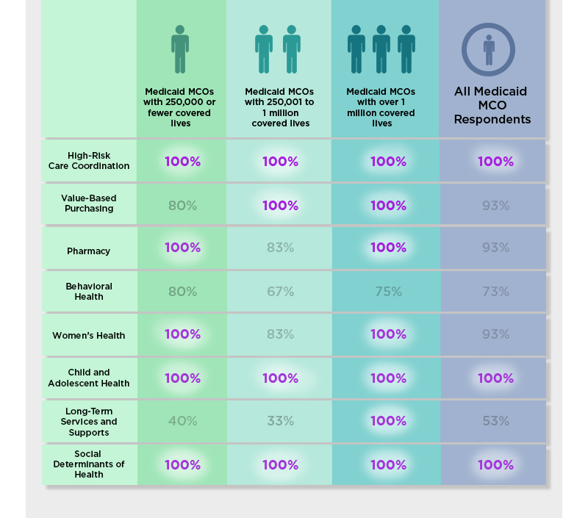
Comparison of Elements of Medicaid MCO
Coverage by Health Plan Size, 2019
Source: Institute for Medicaid Innovation. 2020 Annual Medicaid MCO Survey
Notes:
100 percent of respondents indicating being at full risk for high-risk care coordination, child and adolescent health, and social determinants of health ; regardless of the health plan size. Coverage for managed long-term services and supports was the lowest out of the coverage categories, with 40 percent of small health plans and 33 percent of medium health plans being at-risk. This was in contrast to 100 percent of large health plans.

Slide 9
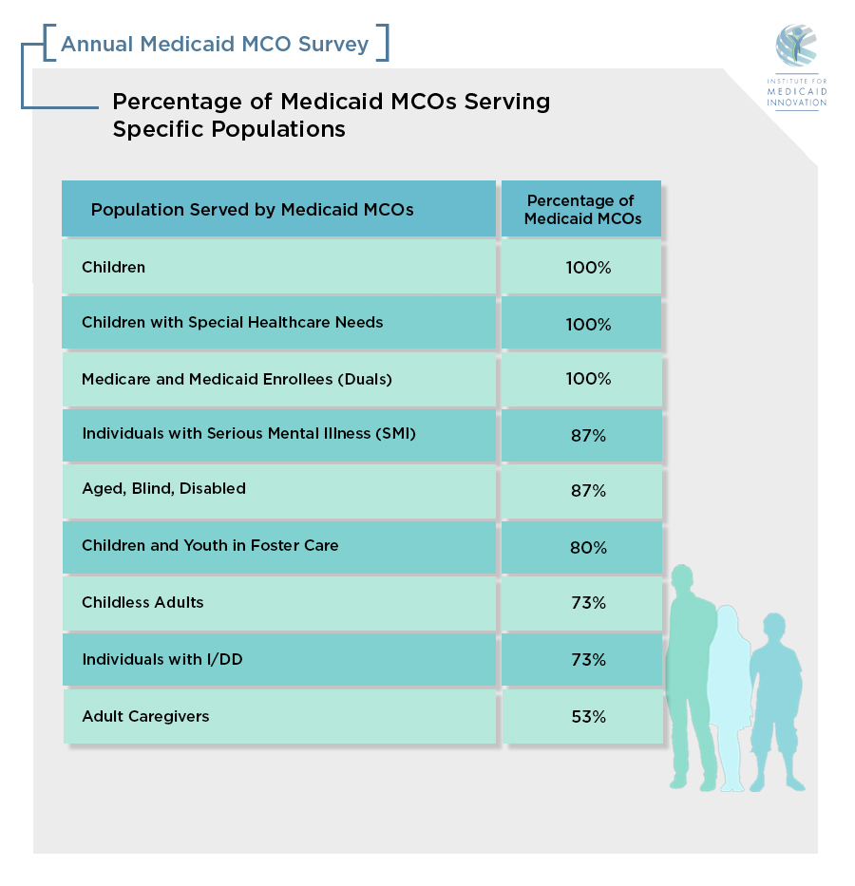
Percentage of Medicaid MCOs Serving
Specific Populations, 2019
Source: Institute for Medicaid Innovation. 2020 Annual Medicaid MCO Survey

Slide 10
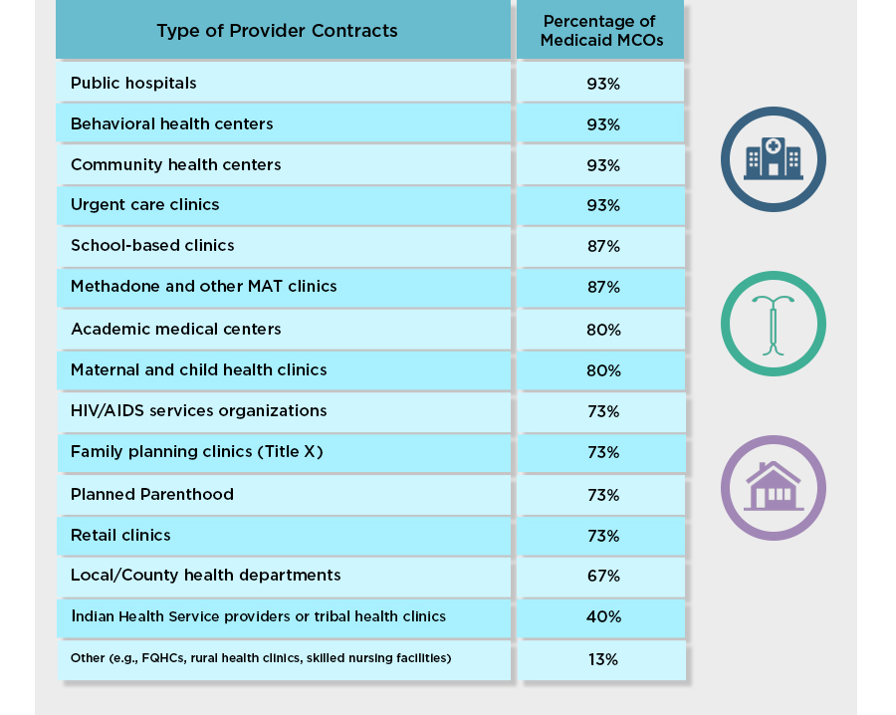
Percentage of Medicaid MCOs with Special
Provider Contracts, 2019
Source: Institute for Medicaid Innovation. 2020 Annual Medicaid MCO Survey
Notes:
67 percent of MCOs contracted with local/county health departments and 93 percent contracted with public hospitals. Despite changes in federal funding for Title X and planned parenthood clinics, there was a 9 percent increase in contracts from the previous year.

Slide 11
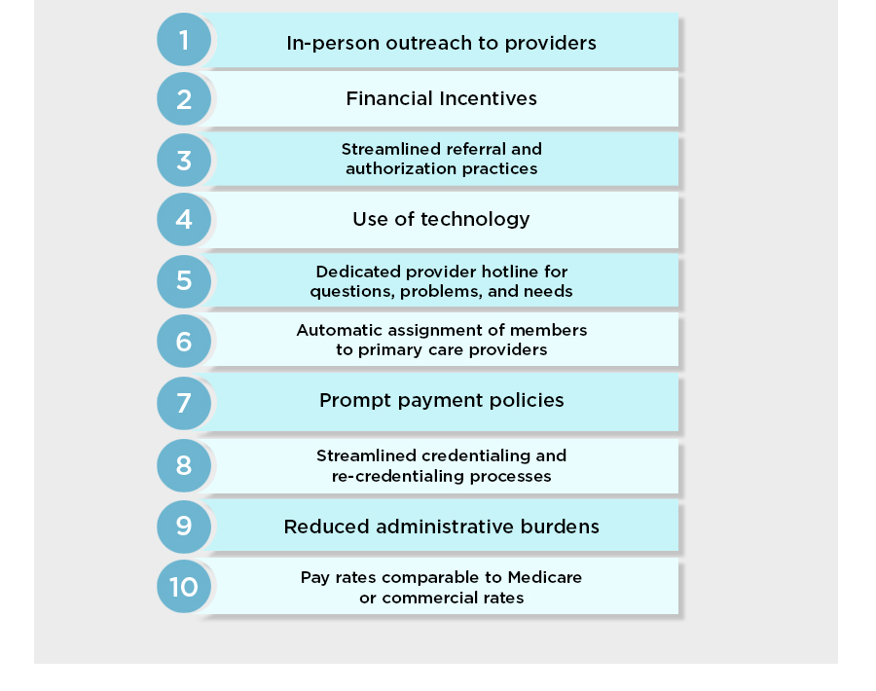
Top 10 Strategies Used by Medicaid MCOs to Recruit
and Retain Providers, 2019
Source: Institute for Medicaid Innovation. 2020 Annual Medicaid MCO Survey
Notes:
In 2019, Medicaid health plans employed multiple strategies to recruit and retrain providers in their network. The top three were in-person outreach, financial incentives, and streamlined referral and authorization practices.

Slide 12
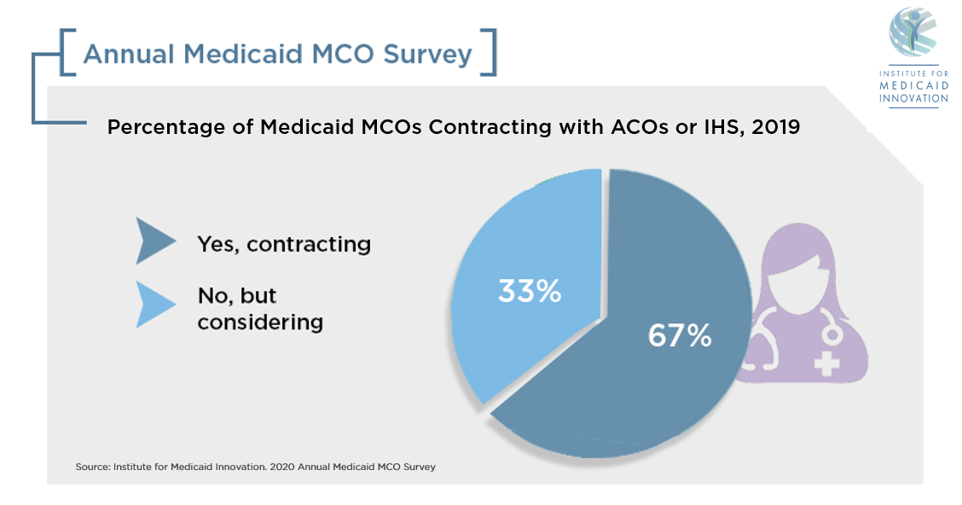

Slide 23
Source: Institute for Medicaid Innovation. 2020 Annual Medicaid MCO Survey

Slide 28
[
]
Pharmacy
Percentage of Medicaid MCOs Fully at Risk for Pharmacy Health Benefits by Health Plan Size, 2017-2019
 | Medicaid MCOs with 250,000 or fewer covered lives | Medicaid MCOs with 250,001 to one million covered lives | Medicaid MCOS with over one million covered lives | All Medicaid MCO respondents
2017 | 100% | 57% | 75% | 69%
2018 | 86% | 80% | 100% | 89%
2019 | 100% | 83% | 100% | 93%
Source: Institute for Medicaid Innovation. 2020 Annual Medicaid MCO Survey

Slide 29
[
]
Pharmacy
93%
93%
of Medicaid MCOs were fully at-risk for
pharmacy benefits in 2019.
The percentage of MCOs at-risk for
pharmacy benefits increased by 24
percentage points from 2017 to 2019.
Source: Institute for Medicaid Innovation. 2020 Annual Medicaid MCO Survey

Slide 30
[
]
Pharmacy
Most Common Challenges in Managing Prescription Drug Benefits in 2019
Utilization and cost history unknown for new drugs entering a market
Increase in number of specialty pharmacy medications
Pharmacy benefits or subset of benefits carved out of managed care
Source: Institute for Medicaid Innovation. 2020 Annual Medicaid MCO Survey

Slide 31
[
]
Pharmacy
Trends in the Most Common Challenges in Managing Medicaid Prescription Drug Benefits from 2017-2019
Challenges | Percentage of Medicaid MCOs in 2019 | Direction of Change from 2017 - 2019
Utilization and cost history unknown for new drugs entering a market | 85%
Increase in number of specialty pharmacy medications | 77% | N/A
Pharmacy benefits or subset of benefits carved out of managed care | 69%
Member comprehension of engagement programs | 62%
Source: Institute for Medicaid Innovation. 2020 Annual Medicaid MCO Survey
Source: Institute for Medicaid Innovation. 2020 Annual Medicaid MCO Survey

Slide 33
[
]
Behavioral Health
Percentage of Medicaid MCOs at Risk for Behavioral Health Benefits, by Health Plan Size, 2017-2019
 | Medicaid MCOs with 250,000 or fewer covered lives | Medicaid MCOs with 250,001 to one million covered lives | Medicaid MCOS with over one million covered lives | All Medicaid MCO respondents
2017 | 50% | 71% | 100% | 77%
2018 | 72% | 80% | 100% | 84%
2019 | 80% | 67% | 75% | 73%
Source: Institute for Medicaid Innovation. 2020 Annual Medicaid MCO Survey

Slide 34
[
]
Behavioral Health
73%
of Medicaid MCOs covered behavioral
health services in 2019.
The most common barriers to behavioral and physical
health integration were access to data between care
management and behavioral health teams and
system differences with subcontractor.
Source: Institute for Medicaid Innovation. 2020 Annual Medicaid MCO Survey

Slide 35
[
]
Behavioral Health
Top operational, network, and policy barriers to integrating behavioral and physical health across all three years of the survey (2017-2019)
Operational
Network
Policy
Access to data between care management and behavioral health teams
Provider capacity to provide integrated physical and behavioral health at point of care
Access to behavioral health providers in select regions (e.g., rural, underserved)
Fragmentation in program funding and contracting for physical and behavioral health services
42 CFR Part 2 limitations on SUD treatment information being shared
Source: Institute for Medicaid Innovation. 2020 Annual Medicaid MCO Survey
Notes:
From 2017 to 2019, the barriers to physical and behavioral health integration persisted. Access to data, provider capacity, access to providers, program and funding fragmentation, and 41 CFR Part 2 limitations were the top barriers that respondents experienced

Slide 37
[
]
Women’s Health
Percentage of Medicaid MCOs with Targeted Women’s Health Programs, by Health Plan Size, 2017-2019
 | Medicaid MCOs with 250,000 or fewer covered lives | Medicaid MCOs with 250,001 to one million covered lives | Medicaid MCOS with over one million covered lives | All Medicaid MCO respondents
2017 | 100% | 86% | 100% | 92%
2018 | 86% | 80% | 100% | 89%
2019 | 100% | 83% | 100% | 93%
Source: Institute for Medicaid Innovation. 2020 Annual Medicaid MCO Survey

Slide 38
[
]
Women’s Health
93%
of Medicaid MCOs provided targeted
women’s health programs in 2019.
100% of health plans indicated that prenatal and postpartum care is a priority and that they have targeted programs and engagement strategies to address this priority.
Source: Institute for Medicaid Innovation. 2020 Annual Medicaid MCO Survey

Slide 39
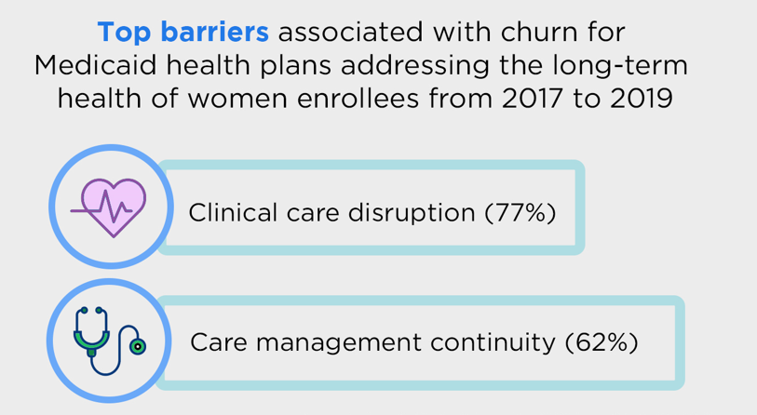
[
]
Women’s Health
Most common impact of churn on Medicaid health plans addressing the long-term health of women enrollees from 2017 to 2019
Source: Institute for Medicaid Innovation. 2020 Annual Medicaid MCO Survey
Notes:
The most common impact of churn across all three years of the survey included clinical care disruption and care management continuity, completeness of member history, and maintaining access to providers and care. The impacts of churn remain consistent barriers to addressing the long-term health of women enrollees.

Slide 41
[
]
Child and Adolescent Health
Percentage of Medicaid MCOs Offering Targeted Child Health Programs by Health Plan Size, 2017-2019
 | Medicaid MCOs with 250,000 or fewer covered lives | Medicaid MCOs with 250,001 to one million covered lives | Medicaid MCOS with over one million covered lives | All Medicaid MCO respondents
2017 | 100% | 86% | 100% | 92%
2018 | 86% | 100% | 100% | 95%
2019 | 100% | 100% | 100% | 100%
Source: Institute for Medicaid Innovation. 2020 Annual Medicaid MCO Survey

Slide 42
[
]
Child and Adolescent Health
100%
of Medicaid MCOs offered targeted
child health programs in 2019.
93% of health plans contracted with a state Medicaid agency to provide coverage for children with special healthcare needs.
Source: Institute for Medicaid Innovation. 2020 Annual Medicaid MCO Survey

Slide 43
[
]
Child and Adolescent Health
Most Common Priority Topics with Targeted Programs and Engagement Strategies in 2019
1
Children with Special Healthcare Needs
Asthma
ADD/ADHD
Behavioral Health Screening and Treatment
2
3
4
Source: Institute for Medicaid Innovation. 2020 Annual Medicaid MCO Survey

Slide 44
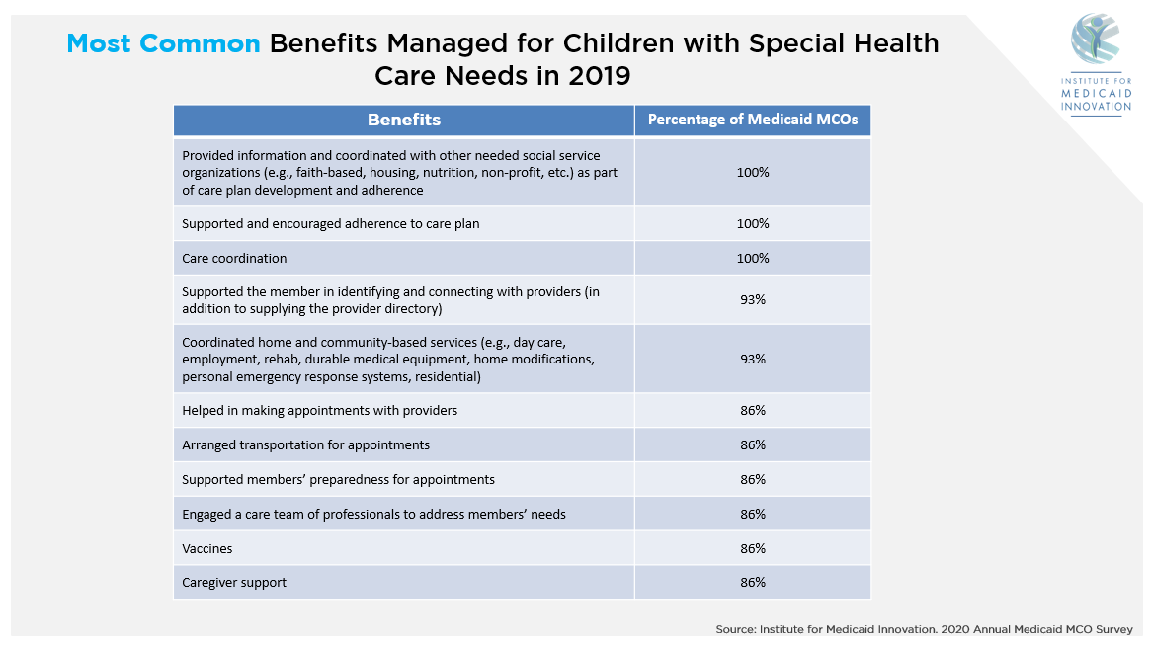

Slide 45
[
]
Child and Adolescent Health
Most Common Barriers for Medicaid MCOs in Addressing Children with Special Healthcare Needs in 2019
Carved-out services created inefficient services for families
Poor communication among multiple providers to families
Carved-out services created an increased risk for duplication and costs
Source: Institute for Medicaid Innovation. 2020 Annual Medicaid MCO Survey
Notes:
The top three barriers in 2019 for children with special healthcare needs included carved out services creating inefficient services for families and an increased risk for duplication and costs, as well as poor communication among multiple providers to families.

Slide 46
[
]
Child and Adolescent Health
In 2019, 20% of Medicaid MCOs indicated that health disparities impacting sexual and gender minorities were a priority for child and adolescent members
13% offered a targeted program and engagement strategy to address those health disparities
43% of MCOs covered gender-affirming care for transgender and gender-nonconforming children with special health care needs in 2019
Source: Institute for Medicaid Innovation. 2020 Annual Medicaid MCO Survey

Slide 48
[
]
Managed Long-Term Services and Supports
53%
of Medicaid MCOs were at-risk for long-term services and supports.
100% of health plans across all three years of the survey (2017-2019) indicated performing the following core functions in MLTSS care coordination models:
Conducted risk assessments
Engaged a care team of professionals to address the needs of the member
Developed a plan of care
Supported and encouraged adherence to care plan
In addition to supplying the provider directory, supported the member in identifying and connecting with providers
Coordinated in-home services
Coordinated home and community-based services
Transition planning (e.g., acute care to residential care; residential care to the community)
Source: Institute for Medicaid Innovation. 2020 Annual Medicaid MCO Survey

Slide 49
[
]
Managed Long-Term Services and Supports
Percentage of Medicaid MCOs at Risk for MLTSS by Health Plan Size, 2017-2019
 | Medicaid MCOs with 250,000 or fewer covered lives | Medicaid MCOs with 250,001 to one million covered lives | Medicaid MCOS with over one million covered lives | All Medicaid MCO respondents
2017 | 50% | 86% | 100% | 85%
2018 | 43% | 60% | 100% | 67%
2019 | 40% | 33% | 100% | 53%
Source: Institute for Medicaid Innovation. 2020 Annual Medicaid MCO Survey

Slide 50
[
]
Managed Long-Term Services and Supports
Common Barriers for Medicaid MCOs in 2019
75%
63%
Medicaid and Medicare
misalignment
State program requirements
Source: Institute for Medicaid Innovation. 2020 Annual Medicaid MCO Survey

Slide 51
[
]
Managed Long-Term Services and Supports
Source: Institute for Medicaid Innovation. 2020 Annual Medicaid MCO Survey

Slide 53
[
]
Social Determinants of Health
Source: Institute for Medicaid Innovation. 2020 Annual Medicaid MCO Survey

Slide 54
[
]
Social Determinants of Health
The most common populations targeted for social determinants of health programs:
Homeless/Housing
Insecure (87%)
Pregnant individuals (73%)
Adults with serious mental illness (67%)
Source: Institute for Medicaid Innovation. 2020 Annual Medicaid MCO Survey

Slide 55
[
]
Social Determinants of Health
50% of Medicaid MCOs utilized an internally developed or adapted SDOH screening tool.
13% did not use a screening tool.
Source: Institute for Medicaid Innovation. 2020 Annual Medicaid MCO Survey

Slide 56
[
]
Social Determinants of Health
Top barriers to serving member social needs
High rate of member churn
Unsustainable resources
CBO capacity and financial support
Inability to pay for non-medical services
Source: Institute for Medicaid Innovation. 2020 Annual Medicaid MCO Survey

