Slide 1
Medicaid Access & Care in 2020
Graphics Featuring Results from the Institute for Medicaid Innovation’s
2021 Annual Medicaid Health Plan Survey

Slide 2
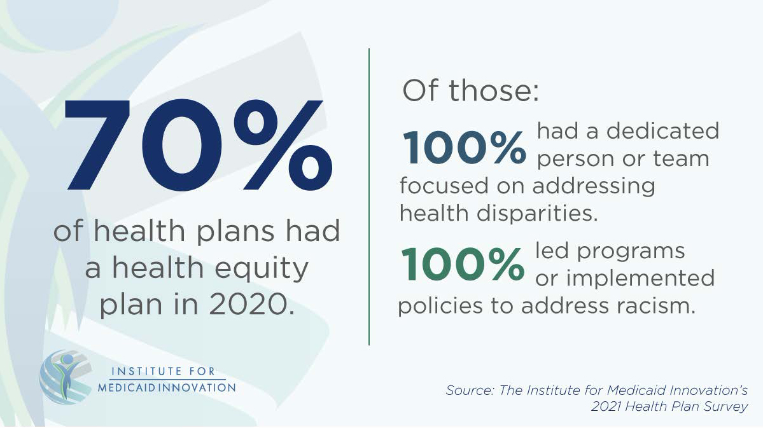

Slide 3
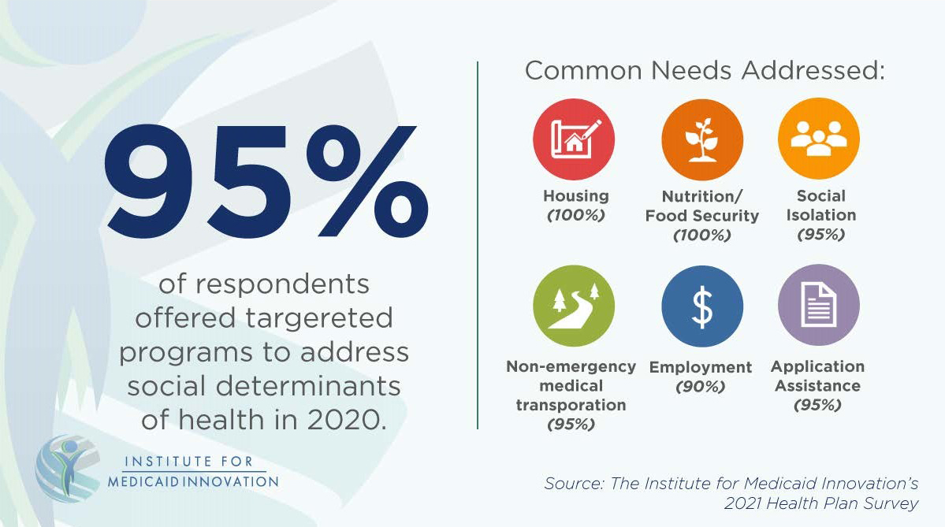

Slide 4
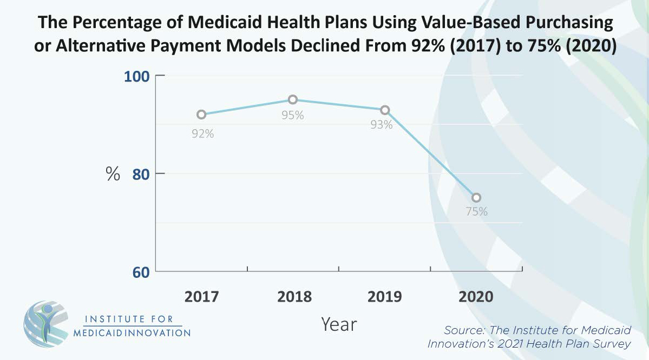

Slide 5
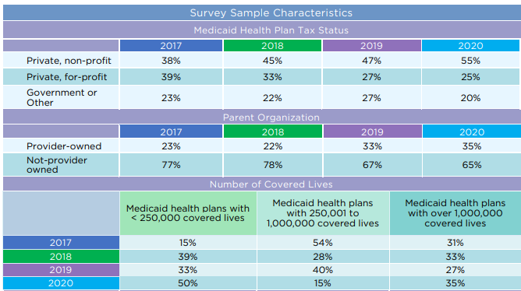
Overview and Sample Characteristics
Table 1. Trends and Overview of Medicaid Health Plan Survey Respondents’ Characteristics, 2017-2020
Source: Institute for Medicaid Innovation. 2021 Annual Medicaid Health Plan Survey.

Slide 6
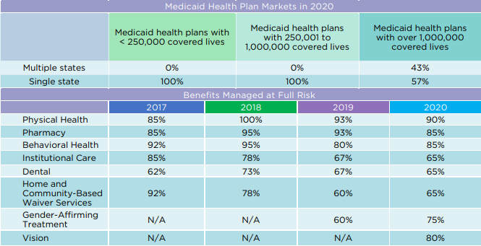
Overview and Sample Characteristics
Table 1. Trends and Overview of Medicaid Health Plan Survey Respondents’ Characteristics, 2017-2020 (Continued)
Note: Benefits were managed at full risk in at least one market.
Source: Institute for Medicaid Innovation. 2021 Annual Medicaid Health Plan Survey.

Slide 7
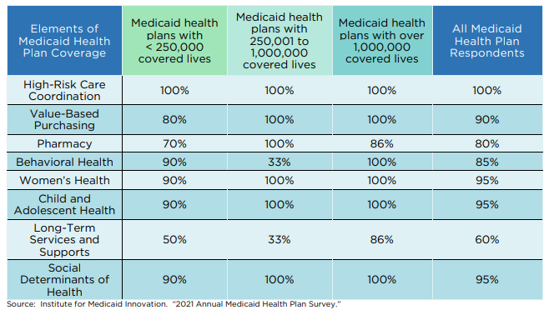
Overview and Sample Characteristics
Table 2. Comparison of Elements of Medicaid Health Plan Coverage by Health Plan Size, 2020
Source: Institute for Medicaid Innovation. 2021 Annual Medicaid Health Plan Survey.

Slide 8
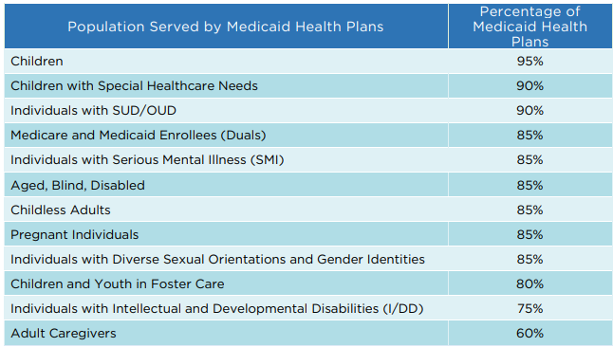
Overview and Sample Characteristics
Table 3. Percentage of Medicaid Health Plans Serving Specific Populations, 2020
Source: Institute for Medicaid Innovation. 2021 Annual Medicaid Health Plan Survey.

Slide 9
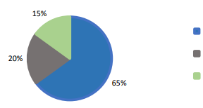
Overview and Sample Characteristics
Figure 1. Percentage of Medicaid Health Plans Offering Targeted Programs to Address the Health of Individuals with Diverse Sexual Orientations and Gender Identities, 2020
15%
Yes (65%)
20%
No, but considering (20%)
No, and not considering (15%)
65%
Source: Institute for Medicaid Innovation. 2021 Annual Medicaid Health Plan Survey.

Slide 10
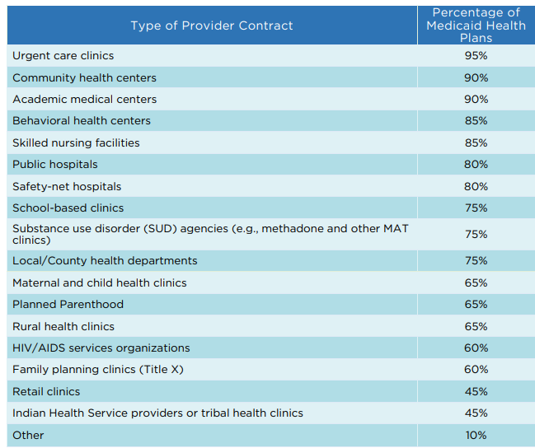
Overview and Sample Characteristics
Table 4. Percentage of Medicaid Health Plans with Specific Provider Contracts, 2020
Note: "Other" included Behavioral Health Homes, Federally Qualified Health Centers (FQHCs), Integrated Community Wellness Centers (ICWCs).
Source: Institute for Medicaid Innovation. 2021 Annual Medicaid Health Plan Survey.

Slide 11
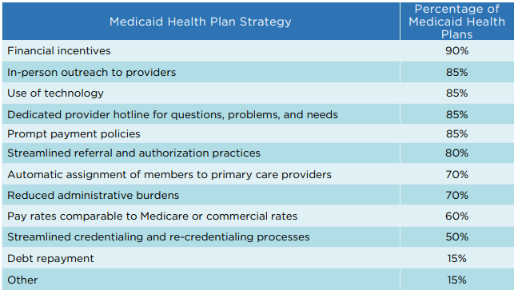
Overview and Sample Characteristics
Table 5. Most Common Strategies Used by Medicaid Health Plans to Recruit and Retain Providers in Medicaid Managed Care, 2020
Note: "Other" included dedicated provider relations staff in the field, value-based care incentives.
Source: Institute for Medicaid Innovation. 2021 Annual Medicaid Health Plan Survey.

Slide 12
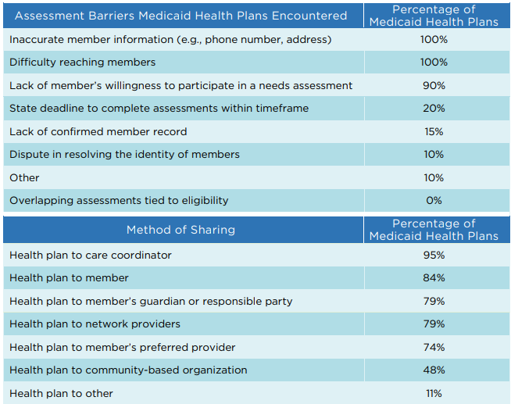
High-Risk Care Coordination
Table 6. Most Common Assessment Barriers in Completing Individual Health Risk Assessments for Members, 2020
Note: "Other" included lack of member phone number, COVID-19.
Source: Institute for Medicaid Innovation. 2021 Annual Medicaid Health Plan Survey.

Slide 13
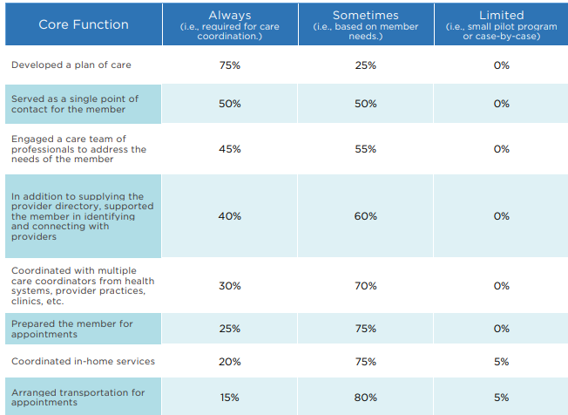
High-Risk Care Coordination
Table 7. Frequency of Core High-Risk Care Coordination Functions Completed by Medicaid Health Plans, 2020
Note: None of the survey respondents selected "did not provide" as an answer for any of the core functions. None of the survey respondents selected "not applicable" as an answer for any of the core functions, except for "Shared data with social services," for which 10 percent of respondents selected "not applicable."
Source: Institute for Medicaid Innovation. 2021 Annual Medicaid Health Plan Survey.

Slide 14
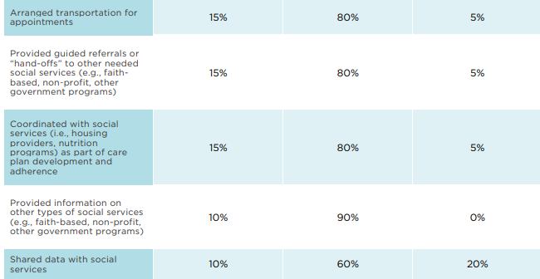
High-Risk Care Coordination
Table 7. Frequency of Core High-Risk Care Coordination Functions Completed by Medicaid Health Plans, 2020 (Continued)
Note: None of the survey respondents selected "did not provide" as an answer for any of the core functions. None of the survey respondents selected "not applicable" as an answer for any of the core functions, except for "Shared data with social services," for which 10 percent of respondents selected "not applicable."
Source: Institute for Medicaid Innovation. 2021 Annual Medicaid Health Plan Survey.

Slide 15
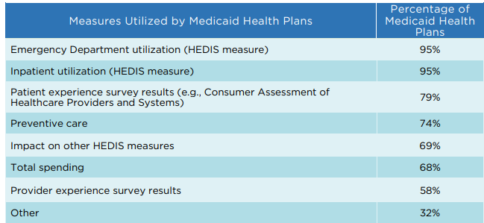
High-Risk Care Coordination
Table 8. Most Common Measures of Effectiveness Used in High-Risk Care Coordination, 2020
Note: "Other" included a care coordination management tool, asthma, heart failure, and diabetes admissions, care coordination complaints, quality measures specific to state contracts, member advisory meetings, and connection rates to the social determinants of health (SDOH).
Source: Institute for Medicaid Innovation. 2021 Annual Medicaid Health Plan Survey.

Slide 16
Value-Based Purchasing
Table 9. Percentage of Medicaid Health Plans Using Value-Based Purchasing (VBP) or Alternative Payment Model (APM) Structures, by Health Plan Size, 2017-2020
Source: Institute for Medicaid Innovation. 2021 Annual Medicaid Health Plan Survey.

Slide 17
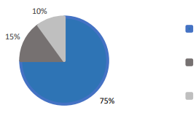
Value-Based Purchasing
Figure 2. Percentage of State Contracts Requiring Medicaid Health Plans to Implement Value-Based Purchasing (VBP) or Alternative Payment Model (APM) Contracting between Medicaid Health Plans and Providers, 2020
10%
Yes (75%)
15%
No, but we anticipate it with the next contract renewal (15%)
75%
Other (10%)
Note: None of the survey respondents selected “No, and not planned with next contract renewal” as an answer for this item.
Source: Institute for Medicaid Innovation. 2021 Annual Medicaid Health Plan Survey.

Slide 18
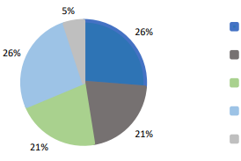
Value-Based Purchasing
Figure 3. Percentage of Value-Based Purchasing (VBP) Implementation within Specific Populations, 2020
5%
26%
Not developed (26%)
26%
Explored but not implemented (21%)
Piloted (21%)
Pilots were expanded (26%)
21%
All of the above (5%)
21%
Note: None of the survey respondents selected “Had extensive arrangements” as an answer for this item. Numbers may not add up to 100 due to rounding.
Source: Institute for Medicaid Innovation. 2021 Annual Medicaid Health Plan Survey.

Slide 19
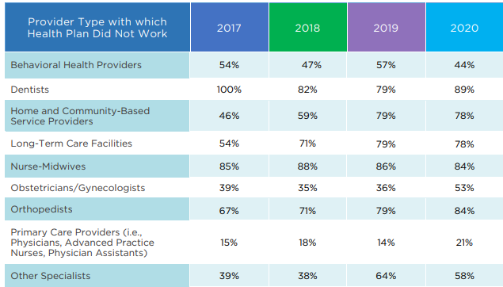
Value-Based Purchasing
Table 10. Provider Types Who Were Not Engaged in Value-Based Purchasing (VBP) Arrangements (Hospitals Excluded), 2020
Source: Institute for Medicaid Innovation. 2021 Annual Medicaid Health Plan Survey.

Slide 20
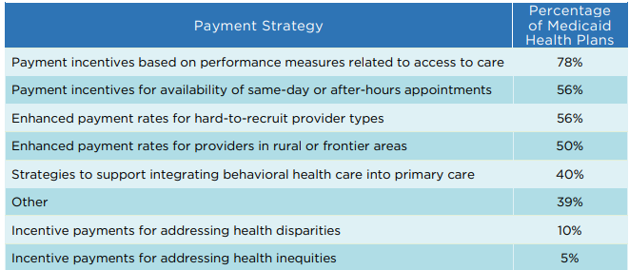
Value-Based Purchasing
Table 11. Most Common Medicaid Health Plan Payment Strategies, 2020
Note: "Other" included capitation contracts, gap closure incentives, grant funds to address disparities, enhanced payments to providers, and payment incentives based on quality performance, care management, and health information exchange participation.
Source: Institute for Medicaid Innovation. 2021 Annual Medicaid Health Plan Survey.

Slide 21
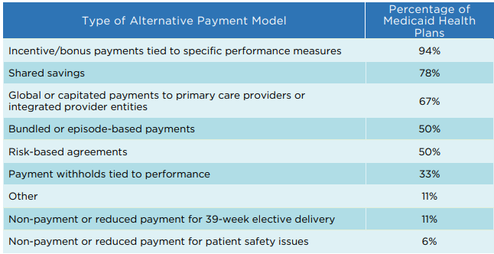
Value-Based Purchasing
Table 12. Most Common Types of APMs Used between Providers and Medicaid Health Plans, 2020
Note: "Other" included per member per month payments for care management and payments tied to enrollment into care management program.
Source: Institute for Medicaid Innovation. 2021 Annual Medicaid Health Plan Survey.

Slide 22
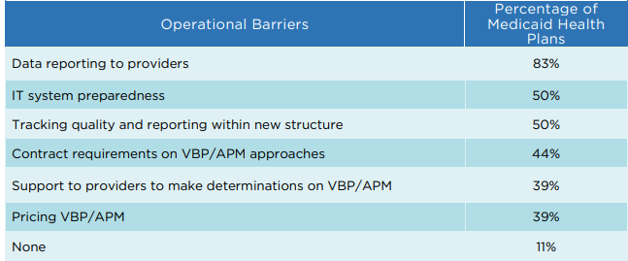
Value-Based Purchasing
Table 13. Most Common Operational Barriers in VBP/APMs, 2020
Source: Institute for Medicaid Innovation. 2021 Annual Medicaid Health Plan Survey.

Slide 23
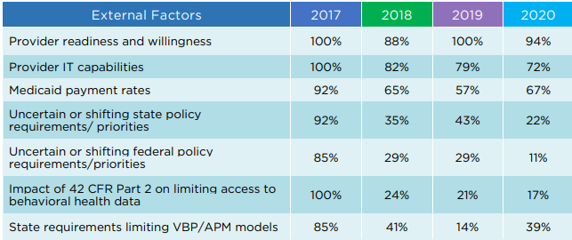
Value-Based Purchasing
Table 14. Trends in Most Common External Factors Influencing Adoption and Innovation in VBP/APMs, 2017-2020
Source: Institute for Medicaid Innovation. 2021 Annual Medicaid Health Plan Survey.

Slide 24
Pharmacy
Table 15. Percentage of Medicaid Health Plans Fully At Risk for Pharmacy Benefits, by Health Plan Size, 2017-2020
Note: Percentages in this table reflect health plans that were fully at-risk for pharmacy benefits in at least one market. Percentages do not include health plans that were at-risk for a portion of the pharmacy spending in at least one market.
Source: Institute for Medicaid Innovation. 2021 Annual Medicaid Health Plan Survey.

Slide 25
Pharmacy
Table 16. Percentage of Medicaid Health Plans Utilizing Pharmacists for Medication Therapy Management, by Health Plan Size, 2020
Source: Institute for Medicaid Innovation. 2021 Annual Medicaid Health Plan Survey.

Slide 26
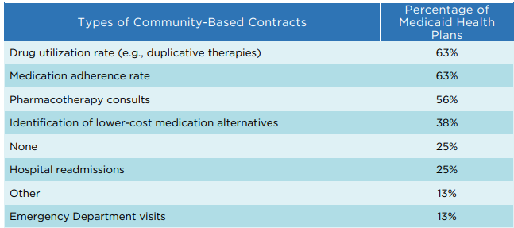
Pharmacy
Table 17. Most Common Ways Community-Based Contracts Were Used with Pharmacists, 2020
Note: "Other" included payments to community pharmacists for chronic care management services.
Source: Institute for Medicaid Innovation. 2021 Annual Medicaid Health Plan Survey.

Slide 27
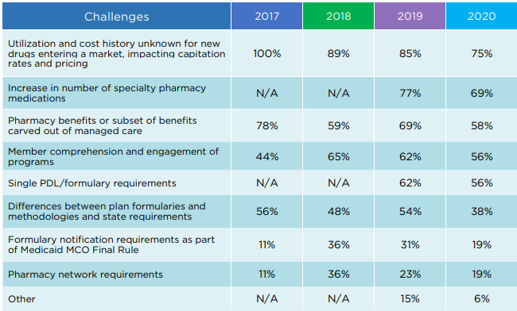
Pharmacy
Table 18. Trends in Most Common Challenges in Managing Medicaid Prescription Drug Benefits, 2017-2020
Note: We are unable to present trend data for some data points that were not answer options for all four years of the survey. “Other” included state interference with contracting. PDL is pregnancy disability leave. Health Plan is managed care organization.
Source: Institute for Medicaid Innovation. 2021 Annual Medicaid Health Plan Survey.

Slide 28
Pharmacy
Table 19. Percentage of Medicaid Health Plans Supporting E-Prescribing through Pharmacy Benefit Managers (PBMs), by Health Plan Size, 2020
Source: Institute for Medicaid Innovation. 2021 Annual Medicaid Health Plan Survey.

Slide 29
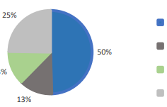
Pharmacy
Figure 4. Utilization of Electronic Prior Authorization Systems, 2020
25%
Yes, it was available through a separate electronic prior authorization portal (50%)
Yes, it was integrated into the provider's electronic health record (13%)
50%
13%
No, but in development (13%)
No (25%)
13%
Note: Numbers might not add up to 100 due to rounding.
Source: Institute for Medicaid Innovation. 2021 Annual Medicaid Health Plan Survey.

Slide 30
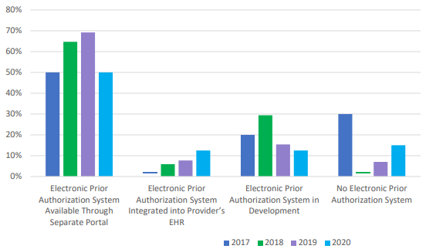
Pharmacy
Figure 5. Trends in Utilization of Electronic Prior Authorization Systems, 2017-2020
Source: Institute for Medicaid Innovation. 2021 Annual Medicaid Health Plan Survey.

Slide 31
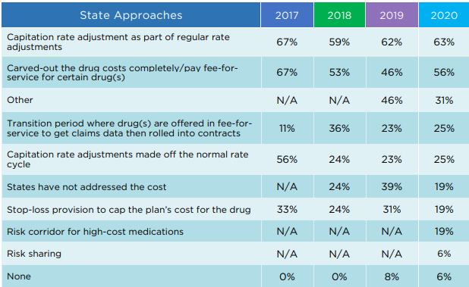
Pharmacy
Table 20. Trends in Most Common Approaches by States to Address New or High-Cost Drugs, 2017-2020
Note: We are unable to present trend data for some data points that were not answer options for all four years of the survey. "Other“ included a state having a single preferred drug list (PDL), a state's PDL promoting use of high-cost brands to collect rebates, value-based all-inclusive arrangements, and supplemental payments.
Source: Institute for Medicaid Innovation. 2021 Annual Medicaid Health Plan Survey.

Slide 32
Behavioral Health
Table 21. Percentage of Medicaid Health Plans At-Risk for Behavioral Health Benefits, by Health Plan Size, 2017-2020
Source: Institute for Medicaid Innovation. 2021 Annual Medicaid Health Plan Survey.

Slide 33
Behavioral Health
Table 22. Most Common Barriers Medicaid Health Plans Experienced when Integrating Behavioral and Physical Health, 2020
Note: "Other" included behavioral health service carve-outs and limited functional outcome measures.
Source: Institute for Medicaid Innovation. 2021 Annual Medicaid Health Plan Survey.

Slide 34
Behavioral Health
Table 22. Most Common Barriers Medicaid Health Plans Experienced when Integrating Behavioral and Physical Health, 2020 (Continued)
Note: "Other" included a workforce shortage or limited network of behavioral health providers, lack of evidence-informed treatment, and behavioral health carve-outs impacting coordination and continuity of care.
Source: Institute for Medicaid Innovation. 2021 Annual Medicaid Health Plan Survey.

Slide 35
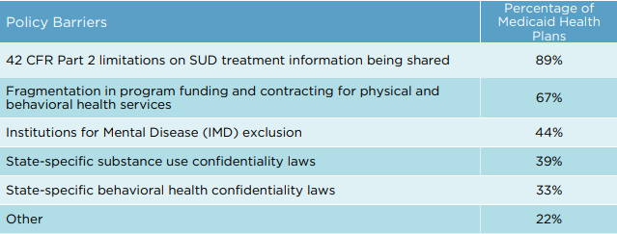
Behavioral Health
Table 22. Most Common Barriers Medicaid Health Plans Experienced when Integrating Behavioral and Physical Health, 2020 (Continued)
Note: "Other" included underfunding of behavioral health services, behavioral health carve-outs impacting coordination and continuity of care, and Mental Health Parity and Addiction Equity (MHPAE) compliance complications.
Source: Institute for Medicaid Innovation. 2021 Annual Medicaid Health Plan Survey.

Slide 36
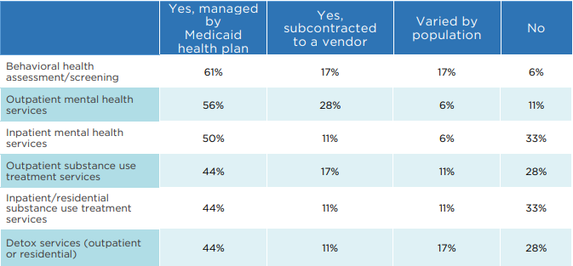
Behavioral Health
Table 23. Behavioral Health Services Included in Contracts with States, 2020
Note: Numbers may not add up to 100 due to rounding.
Source: Institute for Medicaid Innovation. 2021 Annual Medicaid Health Plan Survey.

Slide 37
Women’s Health
Table 24. Percentage of Medicaid Health Plans with Targeted Women’s Health Programs, by Health Plan Size, 2017-2020
Source: Institute for Medicaid Innovation. 2021 Annual Medicaid Health Plan Survey.

Slide 38
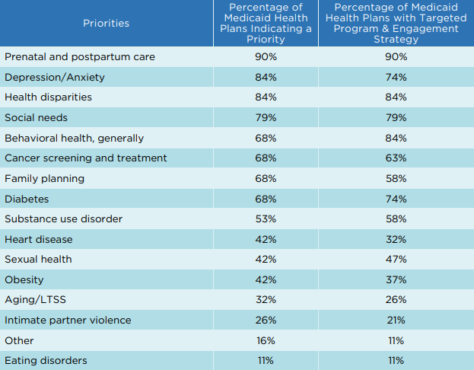
Women’s Health
Table 25. Women’s Health Priorities Identified by Medicaid Health Plans Compared to Targeted Health Plan Programs & Engagement Strategies Across the Lifespan, 2020
Note: "Other" included HIV/AIDS, oral health, and SDOH.
Source: Institute for Medicaid Innovation. 2021 Annual Medicaid Health Plan Survey.

Slide 39
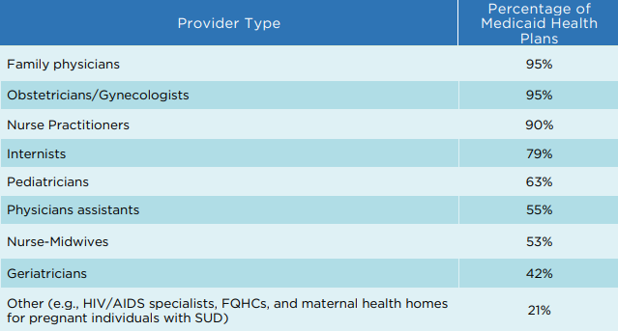
Women’s Health
Table 26. Types of Providers for Primary Care, 2020
Source: Institute for Medicaid Innovation. 2021 Annual Medicaid Health Plan Survey.

Slide 40
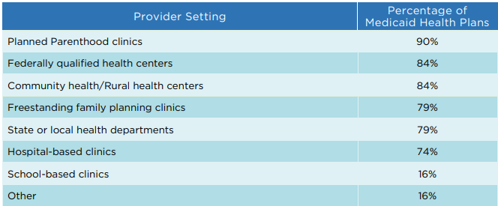
Women’s Health
Table 27. Type of Settings Offering Contraception Counseling and Services, 2020
Note: "Other" included FQHCs, primary care clinics, safety-net clinics.
Source: Institute for Medicaid Innovation. 2021 Annual Medicaid Health Plan Survey.

Slide 41
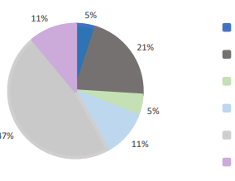
Women’s Health
Figure 6. Timing of Postpartum Contraception or Sterilization Information Provided by Medicaid Health Plans, 2020
11%
5%
Never (5%)
21%
If the member asks (21%)
Immediate post-partum (i.e., during inpatient stay for delivery) (5%)
5%
Within 6 weeks post-partum (11%)
47%
Prior to birth (47%)
11%
Annually to all women of reproductive age (11%)
Source: Institute for Medicaid Innovation. 2021 Annual Medicaid Health Plan Survey.

Slide 42
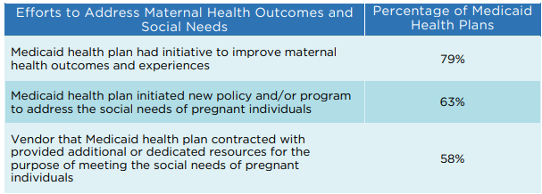
Women’s Health
Table 28. Percentage of Medicaid Health Plans Addressing Maternal Health Outcomes and Social Needs, 2020
Source: Institute for Medicaid Innovation. 2021 Annual Medicaid Health Plan Survey.

Slide 43
Women’s Health
Table 29. Reported Degree of Commitment to Addressing the Social Needs of Pregnant Individuals, 2020
Note: None of the survey respondents selected "no interest" as an answer for any of these items.
Source: Institute for Medicaid Innovation. 2021 Annual Medicaid Health Plan Survey.

Slide 44
Child & Adolescent Health
Table 30. Percentage of Medicaid Health Plans Offering Targeted Child Health Programs, by Health Plan Size, 2017-2020
Source: Institute for Medicaid Innovation. 2021 Annual Medicaid Health Plan Survey.

Slide 45
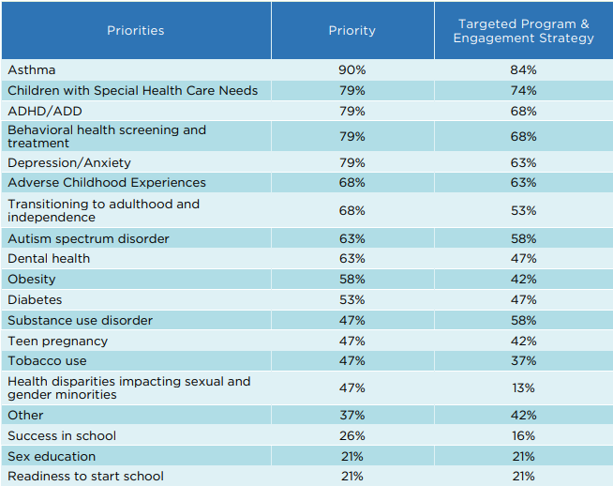
Child & Adolescent Health
Table 31. Child & Adolescent Health Priorities Identified by Medicaid Health Plans Compared to Targeted Health Plan Programs & Engagement Strategies, 2020
Note: "Other" included lead screenings, metabolic monitoring for children and adolescents related to anti-psychotics, the social determinants of health (SDOH), children in foster care, and developmental screenings.
Source: Institute for Medicaid Innovation. 2021 Annual Medicaid Health Plan Survey.

Slide 46
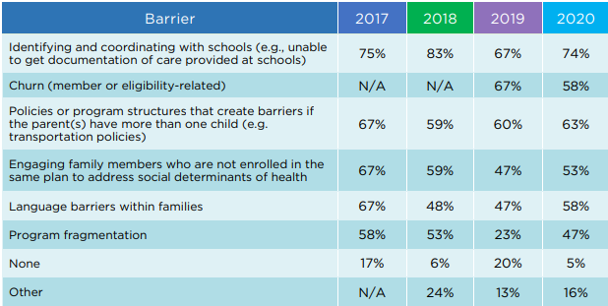
Child & Adolescent Health
Table 32. Trends in Most Common Barriers for Medicaid Health Plans for Serving Child and Adolescent Members, 2017-2020
Note: We are unable to present a data trend for "Churn" as it was not an answer option for all four years of the survey. "Other“ included COVID-19 disruptions to well visits and immunizations, behavioral health service carve-outs, private duty nurse workforce shortages, coordination with the Department of Child Services, and care coordination for infants with Neonatal Abstinence Syndrome.
Source: Institute for Medicaid Innovation. 2021 Annual Medicaid Health Plan Survey.

Slide 47
Child & Adolescent Health
Table 33. Percentage of Medicaid Health Plans Contracting with State Medicaid Agencies for Children with Special Healthcare Needs (CSHCN), by Health Plan Size, 2020
Source: Institute for Medicaid Innovation. 2021 Annual Medicaid Health Plan Survey.

Slide 48
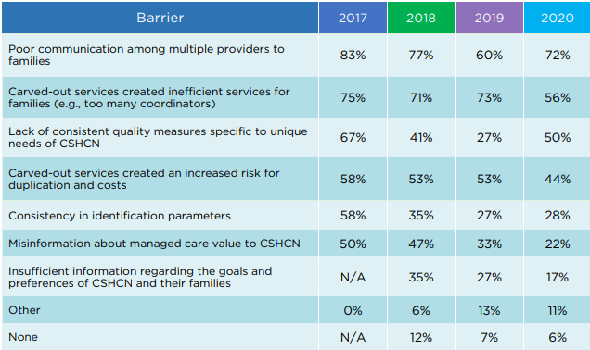
Child & Adolescent Health
Table 34. Trends in the Most Common Barriers Experienced by Medicaid Health Plans when Serving CSHCN, 2017-2020
Note: We are unable to present trend data for some data points that were not answer options for all four years of the survey. "Other“ included lack of coordination across state agencies and whole person care.
Source: Institute for Medicaid Innovation. 2021 Annual Medicaid Health Plan Survey.

Slide 49
Managed Long-Term Services and Supports
Table 35. Percentage of Medicaid Health Plans At-Risk for Managed Long-Term Services and Supports (MLTSS), by Health Plan Size, 2017-2020
Source: Institute for Medicaid Innovation. 2021 Annual Medicaid Health Plan Survey.

Slide 50
Managed Long-Term Services and Supports
Table 36. Percentage of Medicaid Health Plans Utilizing a Different Clinical Model of Care for Managed Long-Term Services and Supports (MLTSS) Members, by Health Plan Size, 2020
Source: Institute for Medicaid Innovation. 2021 Annual Medicaid Health Plan Survey.

Slide 51
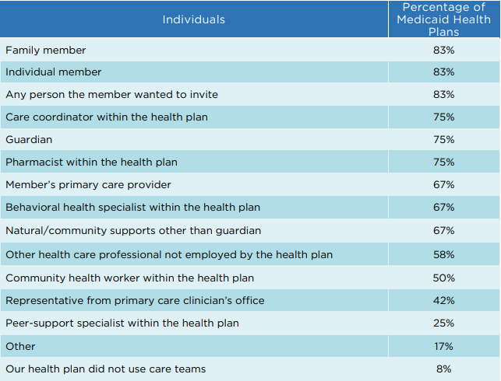
Managed Long-Term Services and Supports
Table 37. Most Common Individuals in Care Team Composition for Managed Long-Term Services and Supports (MLTSS), 2020
Note: “Other” included MLTSS providers, member advocates, medical directors, state agency representatives.
Source: Institute for Medicaid Innovation. 2021 Annual Medicaid Health Plan Survey.

Slide 52
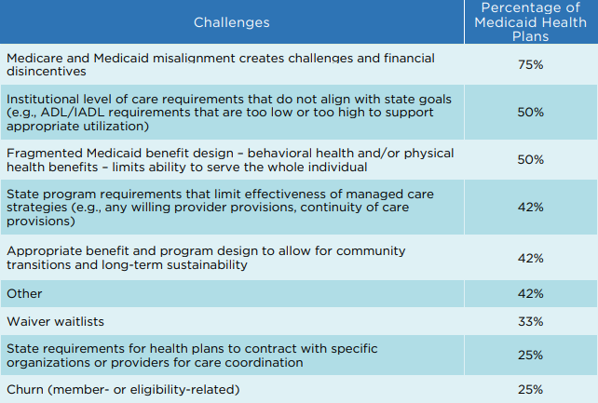
Managed Long-Term Services and Supports
Table 38. Most Common Challenges to Managing Long-Term Services and Supports (MLTSS), 2020
Note: "Other" included provider availability, change in members’ health plan, adequacy of HCBS network, disparities between financial eligibility for Medicaid and waiver programs, and member concerns about COVID-19 exposure.
Source: Institute for Medicaid Innovation. 2021 Annual Medicaid Health Plan Survey.

Slide 53
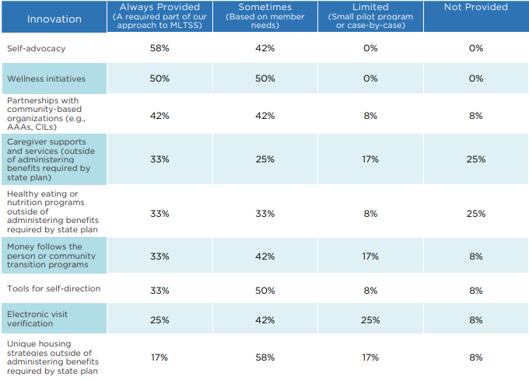
Managed Long-Term Services and Supports
Table 39. Frequency of Innovations Leveraged by Medicaid Health Plans for Managed Long-Term Services and Supports (MLTSS), 2020
Note: Numbers may not add up to 100% due to rounding.
Source: Institute for Medicaid Innovation. 2021 Annual Medicaid Health Plan Survey.

Slide 54
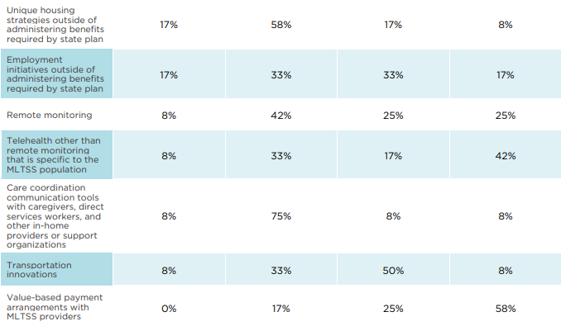
Managed Long-Term Services and Supports
Table 39. Frequency of Innovations Leveraged by Medicaid Health Plans for Managed Long-Term Services and Supports (MLTSS), 2020 (Continued)
Note: Numbers may not add up to 100% due to rounding.
Source: Institute for Medicaid Innovation. 2021 Annual Medicaid Health Plan Survey.

Slide 55
Social Determinants of Health
Table 40. Percentage of Medicaid Health Plans with Targeted Social Determinants of Health Programs, by Health Plan Size, 2018-2020
Source: Institute for Medicaid Innovation. 2021 Annual Medicaid Health Plan Survey.

Slide 56
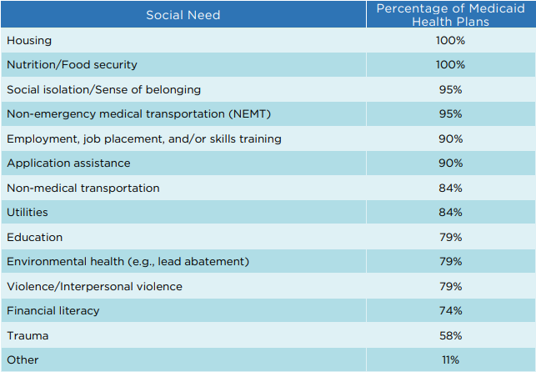
Social Determinants of Health
Table 41. Most Common Social Needs Programs Led by Medicaid Health Plans for Their Members, 2020
Note: No respondents selected "Not assessed/No information collected." “Other” included SSI assistance, substance use, health care.
Source: Institute for Medicaid Innovation. 2021 Annual Medicaid Health Plan Survey.

Slide 57
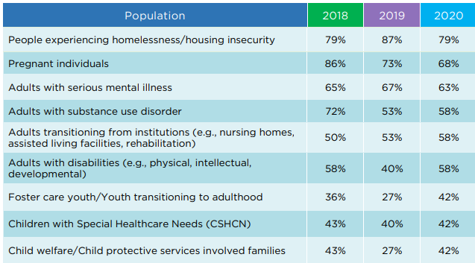
Social Determinants of Health
Table 42. Trends in Targeted Social Determinants of Health Programs, Provided by Medicaid Health Plans, by Population, 2018-2020
Note: We are unable to present trend data for some data points that were not included an answer options for all four years of the survey.
Source: Institute for Medicaid Innovation. 2021 Annual Medicaid Health Plan Survey.

Slide 58
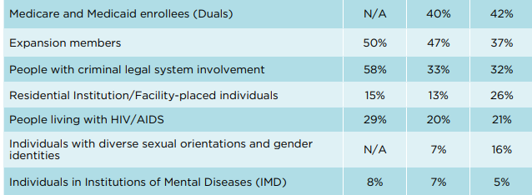
Social Determinants of Health
Table 42. Trends in Targeted Social Determinants of Health Programs, Provided by Medicaid Health Plans, by Population, 2018-2020 (Continued)
Note: We are unable to present trend data for some data points that were not included an answer options for all four years of the survey.
Source: Institute for Medicaid Innovation. 2021 Annual Medicaid Health Plan Survey.

Slide 59
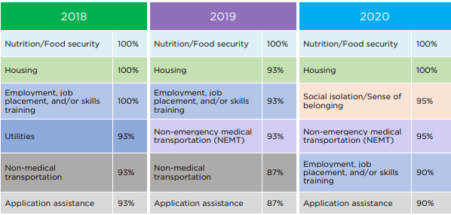
Social Determinants of Health
Table 43. Trends in Most Common Social Needs Programs Led by Medicaid Health Plans for Their Members, 2018-2020
Source: Institute for Medicaid Innovation. 2021 Annual Medicaid Health Plan Survey.

Slide 60
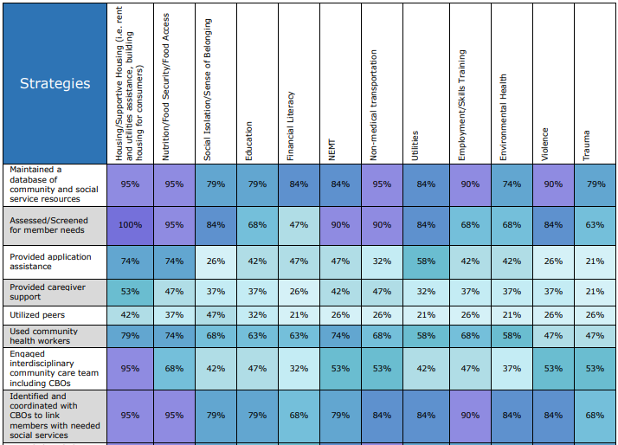
Social Determinants of Health
Table 44. Percentage of Medicaid Health Plans Providing Targeted Strategies to Address Social Needs, 2020
Notes: IEP is individualized education plan. CBOs is community-based organizations.
Source: Institute for Medicaid Innovation. 2021 Annual Medicaid Health Plan Survey.

Slide 61
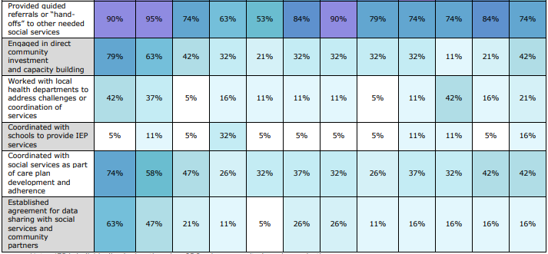
Social Determinants of Health
Table 44. Percentage of Medicaid Health Plans Providing Targeted Strategies to Address Social Needs, 2020 (Continued)
Notes: IEP is individualized education plan. CBOs is community-based organizations.
Source: Institute for Medicaid Innovation. 2021 Annual Medicaid Health Plan Survey.

Slide 62
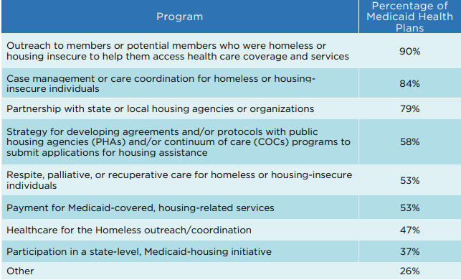
Social Determinants of Health
Table 45. Most Common Programs Led by Medicaid Health Plans to Assist with Homelessness or Housing Instability, 2020
Note: "Other" included investment in permanent housing and supports for families and provision of funds for member housing needs.
Source: Institute for Medicaid Innovation. 2021 Annual Medicaid Health Plan Survey.

Slide 63
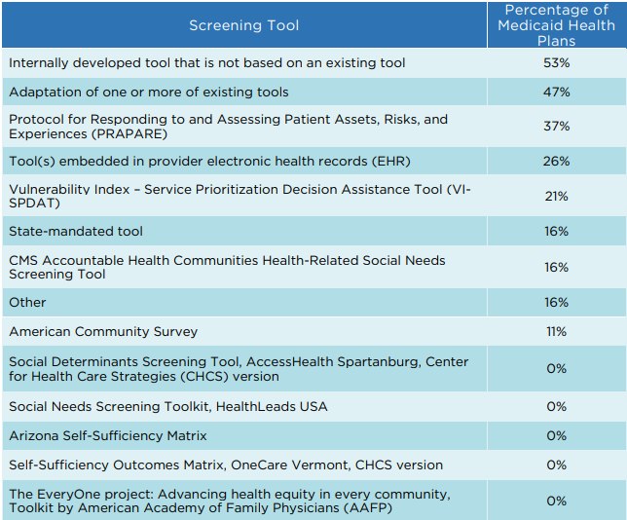
Social Determinants of Health
Table 46. Most Common Social Determinant of Health Screening Tools Used by Medicaid Health Plans, 2020
Note: “Other” included CMS/NCQA Model of Care Health Risk Assessment for C-SNP, EPIC EHR SDOH survey)
Source: Institute for Medicaid Innovation. 2021 Annual Medicaid Health Plan Survey.

Slide 64
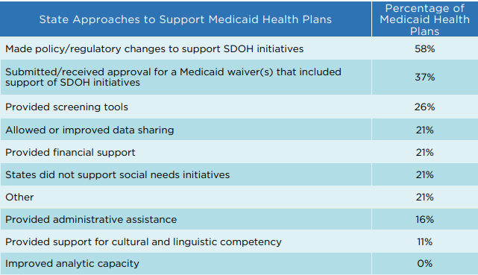
Social Determinants of Health
Table 47. Most Common Approaches Used by States to Support the Efforts of Medicaid Health Plans to Address Social Needs, 2020
Notes: SDOH is social determinants of health. "Other" included planned SDOH initiatives with financial support to start in 2021, provided training on trauma-informed care and adverse childhood experiences, led an SDOH collaborative, and conducted a needs assessment.
Source: Institute for Medicaid Innovation. 2021 Annual Medicaid Health Plan Survey.

Slide 65
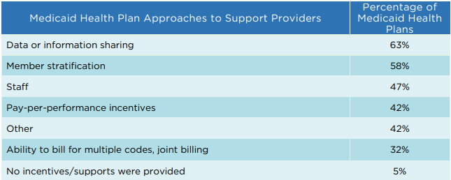
Social Determinants of Health
Table 48. Most Common Approaches Used by Medicaid Health Plans to Support Provider Efforts to Address Social Needs, 2020
Note: "Other" included provided screening incentives, trainings, capacity building webinars, and dedicated housing and intake staff, implemented Aunt Bertha, tracked receipt of referrals from providers for the social determinants of health (SDOH), and developed an SDOH referral process to be used by clinics.
Source: Institute for Medicaid Innovation. 2021 Annual Medicaid Health Plan Survey.

Slide 66
Social Determinants of Health
Figure 7. Most Common Metrics Used by Medicaid Health Plans to Assess and Evaluate Social Determinants of Health Initiatives, 2020
Source: Institute for Medicaid Innovation. 2021 Annual Medicaid Health Plan Survey.

Slide 67
Social Determinants of Health
Table 49. Most Common Barriers State Medicaid Agencies Could Remove to Assist Medicaid Health Plans in Addressing Social Needs of Medicaid Members, 2020
Note: SDOH is social determinants of health. Health Plans is managed care organizations. "Other" included build infrastructure to include detoxification/rehabilitation facilities, adopt a common platform for SDOH referrals and CBO engagement, and improve reporting of race/ethnicity.
Source: Institute for Medicaid Innovation. 2021 Annual Medicaid Health Plan Survey.

Slide 68
Social Determinants of Health
Table 50. Most Common Z Codes Used by Providers, 2020
Source: Institute for Medicaid Innovation. 2021 Annual Medicaid Health Plan Survey.

Slide 69
COVID-19 Pandemic
Table 51. Changes Made by Medicaid Health Plans That Will Support Preparation for the Next Public Health Emergency, 2020
Source: Institute for Medicaid Innovation. 2021 Annual Medicaid Health Plan Survey.

Slide 70
COVID-19 Pandemic
Table 52. Transitional Care Support Provided by Medicaid Health Plans for Enrollees Who Were Housing Insecure and Recovering from COVID-19, 2020
Source: Institute for Medicaid Innovation. 2021 Annual Medicaid Health Plan Survey.

Slide 71
COVID-19 Pandemic
Table 53. Resources and Support Provided by Medicaid Health Plans to Community-Based Organizations during the Pandemic, 2020
Source: Institute for Medicaid Innovation. 2021 Annual Medicaid Health Plan Survey.

Slide 72
COVID-19 Pandemic
Table 54. Changes Enacted by Medicaid Health Plans Related to Telehealth, 2020
Note: "Other" included collaborated with state on commitment to regulatory changes, implemented a platform for after-hour care and support, increased education related to telehealth for members and providers, and invested in capacity building with providers.
Source: Institute for Medicaid Innovation. 2021 Annual Medicaid Health Plan Survey.

Slide 73
COVID-19 Pandemic
Table 55. Medicaid Health Plan Utilization Management Changes over the Past Year, 2020
Source: Institute for Medicaid Innovation. 2021 Annual Medicaid Health Plan Survey.

Slide 74
COVID-19 Pandemic
Table 56. How Medicaid Health Plans Closed Gaps in HEDIS Measures with Fewer In-Person Visits, 2020
Note: HEDIS is Healthcare Effectiveness Data and Information Set.
Source: Institute for Medicaid Innovation. 2021 Annual Medicaid Health Plan Survey.

Slide 75
Health Equity and Structural Racism
Figure 8. Percentage of Medicaid Health Plans with a Health Equity Plan, 2020
30%
Yes (70%)
No (30%)
70%
Source: Institute for Medicaid Innovation. 2021 Annual Medicaid Health Plan Survey.

Slide 76
Health Equity and Structural Racism
Table 57. Medicaid Health Plans with Dedicated Person or Team, 2020
Source: Institute for Medicaid Innovation. 2021 Annual Medicaid Health Plan Survey.

Slide 77
Health Equity and Structural Racism
Figure 9. Percentage of Medicaid Health Plans with a Health Equity or Disparities Strategy or Approach, 2020
7%
Yes (93%)
No (7%)
93%
Source: Institute for Medicaid Innovation. 2021 Annual Medicaid Health Plan Survey.

Slide 78
Health Equity and Structural Racism
Table 58. Populations for Which Medicaid Health Plans Had a Health Equity or Disparities Strategy or Approach, 2020
Notes: The most common specific member populations that were identified included pregnant individuals, LGBTQ+ members, children and adolescents, and people of color. “Other” included vendors.
Source: Institute for Medicaid Innovation. 2021 Annual Medicaid Health Plan Survey.

Slide 79
Health Equity and Structural Racism
Table 59. Actions Taken by Medicaid Health Plans to Incorporate Public Health Data in Health Equity or Disparities Strategy or Approach, 2020
Source: Institute for Medicaid Innovation. 2021 Annual Medicaid Health Plan Survey.

Slide 80
Health Equity and Structural Racism
Table 60. Approaches Utilized to Address Mis/Distrust and Past Trauma Interacting with Health Care System, 2020
Source: Institute for Medicaid Innovation. 2021 Annual Medicaid Health Plan Survey.

