Slide 1
Social Media Graphics for Improving Maternal Health Access, Coverage, and Outcomes in Medicaid
May 2020

Slide 2
Overview of the Report
The following graphics are from the Institute of Medicaid Innovation’s comprehensive report, Improving Maternal Health Access, Coverage, and Outcomes in Medicaid: A Resource for State Medicaid Agencies and Medicaid Managed Care Organizations. The report can be accessed at https://www.medicaidinnovation.org/current-initiatives/womens-health.
The following social media graphics refer to the report’s findings, including highlighting case studies of organizations that are currently developing and implementing midwifery-led care and birth center services.

Slide 3
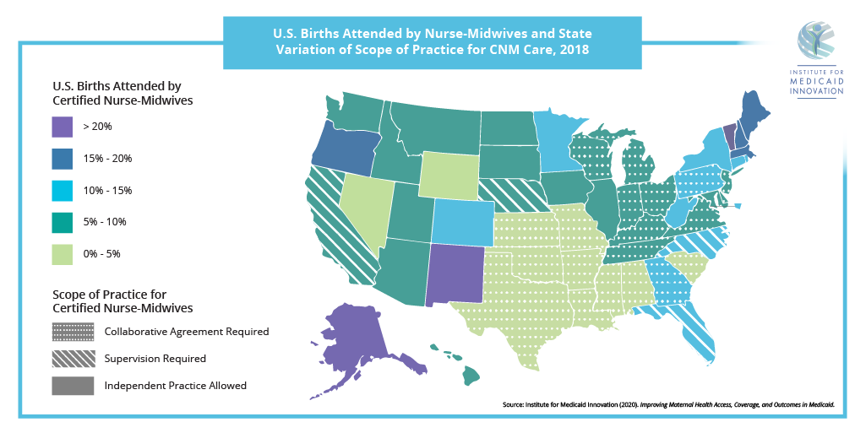

Slide 9
